Slide 1
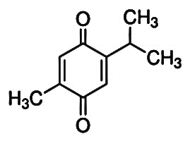
Bringging to you the ONE and ONLY ONE.............
Habbatus Sauda (Nigella sativa),
Vitamin D, Zinc, Magnesium
dan Monk Fruit.
SATIVAplus

Slide 2
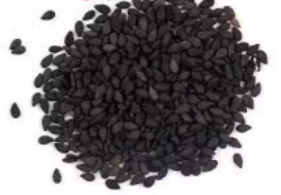
What is Nigella sativa?
Nigella sativa is a herb which has been used as medicine for hundreds of years by communities around the globe for various medicinal purposes.

Slide 3
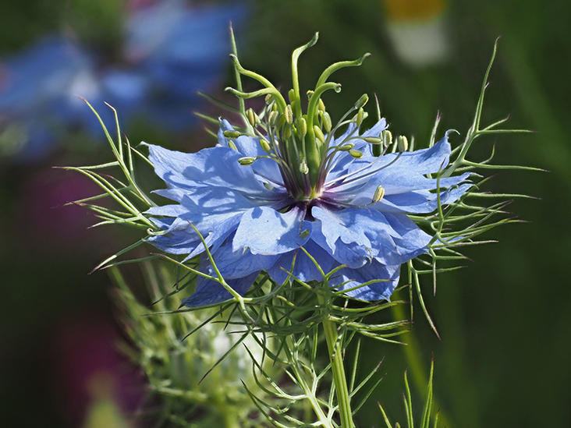
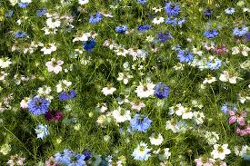
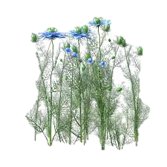
Nigella sativa
a member of Ranunculaceae family.
Al-Habba Al-Sauda'
Al-Habba Al-Barakah’
Habbatusauda
Kalonji
Black seed or dark cumin

Slide 4
Habbatus Sauda Mengandungi
Thymoquinone
Nama saintifik Habbatus Sauda adalah Nigella sativa
Formulasi SATIVAplus terdiri daripada
Habbatus Sauda (Nigella sativa),
Vitamin D, Zinc, Magnesium
dan Monk Fruit.
Berdaftar sebagai Produk Makanan
Kesihatan oleh Kementerian Kesihatan
Malaysia

Slide 5
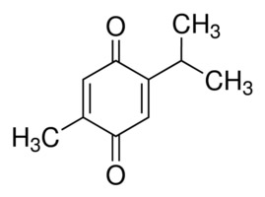
Nigella sativa possesses the following activities and helps in these conditions:
antioxidant,
constipation,
anti-inflammatory,
antiviral,
immunomodulatory
anticoagulant
Antihypertensive
Diabetis
Anticholesterol
Gout.
Thymoquinone, the main active ingredient of Nigella sativa.
Thymoquinone

Slide 8
Kesan Anti-Radang
(Anti Inflammatory Effects)
Keradangan mempunyai kesan yang sangat ketara pada pelbagai organ.
Thymoquinone membantu menghalang enzim tertentu dalam badan yang bertanggungjawab menyebabkan keradangan pada tisu.
Antiradang membantu mengurangkan beberapa kesan yang tidak diingini dan mengurangkan penderitaan dan ketidakselesaan dalam pelbagai penyakit.

Slide 9
Nigella sativa IS VERY HIGH IN ANTIOXIDANT
Thymoquinone
Antioxidant effects
Antioxidants are very important group of chemicals that can prevent oxidation and also prevent unnecessary damage to the cells and various organ systems due to oxidation process.

Slide 10
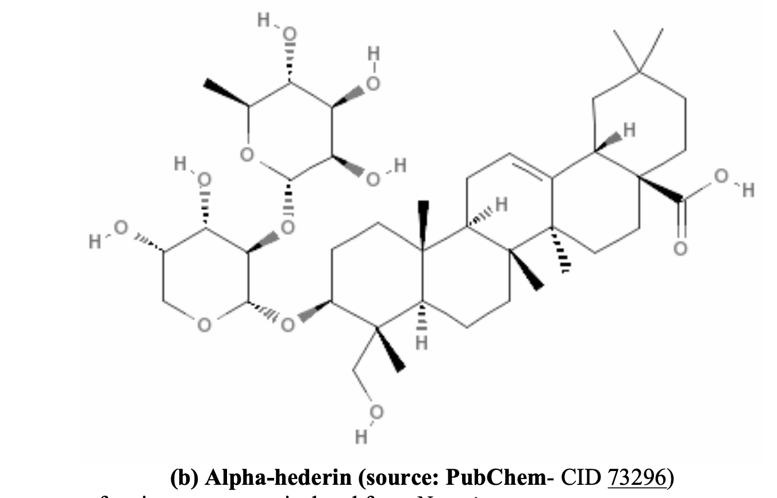
Nigella sativa has ANTICANCER properties
Nigella sativa seeds contains active ingredients like thymoquinone and alpha-hederin which are effective against different cancers.

Slide 11
Kelebihan Nigella sativa
Anti-Radang
Imunomodulatori
Membantu dalam mengurangkan
keradangan dalam badan,
yang dikaitkan dengan
banyak penyakit kronik anti-radang
Membantu untuk menguatkan
sistem imun, yang boleh
membantu untuk melindungi
daripada jangkitan dan penyakit
lain
Penambahan Tenaga
Membantu meningkatkan tahap
tenaga dan melawan keletihan.

Slide 12
Kelebihan Nigella sativa
Anti-Oksida
Membantu melindungi daripada
kerosakan disebabkan oleh radikal
bebas dalam badan
Menurunkan Paras Gula
Mengurangkan Paras Kolestrol
Membantu menurunkan paras gula dalam darah bagi penghidap diabetes
Membantu mengurangkan tahap kolesterol yang
boleh membantu untuk melindungi daripada
penyakit jantung

Slide 13
Kelebihan SATIVAplus
(Nigella sativa)
Diabetes (Kencing Manis)
Mengurangkan paras glukos
Membantu memulihkan berat badan
Memberi tenaga
Menguatkan otot-otot
Mengurangkan kebas-kebas anggota badan

Slide 14
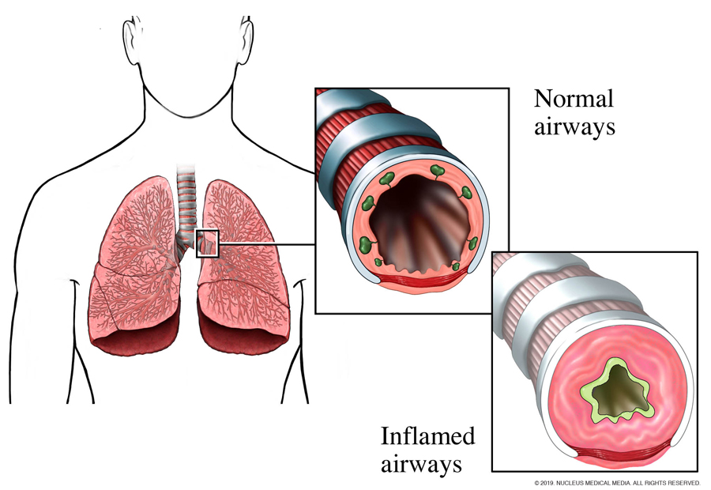
Kelebihan SATIVAplus
(Nigella sativa)
ANTI-RADANG
Asthma
Batuk
Membantu mengurangkan kekerapan
serangan, keterukan Asthma dan Batuk

Slide 15
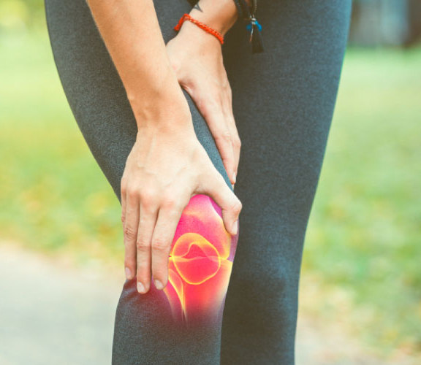
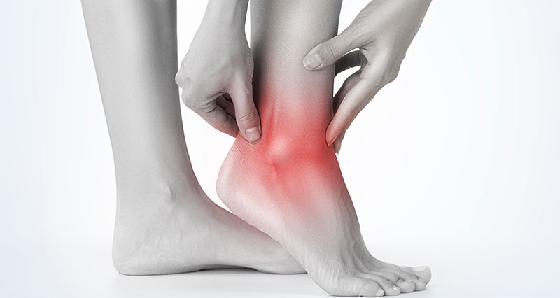
Kelebihan SATIVAplus
(Nigella sativa)
ANTI-RADANG
Gout, Arthritis, Tendonitis & Bursitis
Membantu mengurangkan kesakitan dan bengkak
Membantu meningkatkan mobiliti sendi dan mengurangkan kekakuan

Slide 16
Kelebihan SATIVAplus
(Nigella sativa)
ANTI-RADANG
Rhinitis (Resdung)
Membantu memberikan kelegaan daripada gejala rhinitis (resdung)

Slide 17
Kelebihan SATIVAplus
(Nigella sativa)
ANTI-RADANG
KESAKITAN
Membantu mengurangkan bengkak dan kesakitan

Slide 18
Kelebihan SATIVAplus
(Nigella sativa)
ANTI-RADANG
MENGURANGKAN KEKERAPAN KENCING

Slide 19
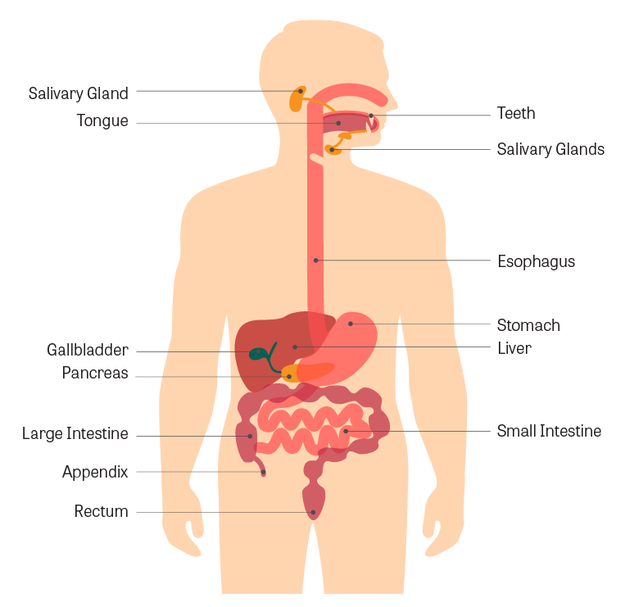
Kelebihan SATIVAplus
(Nigella sativa)
MELAWASKAN BUANG AIR BESAR
MENGURANGKAN GEJALA GASTRIK

Slide 20
Kelebihan SATIVAplus
Dan Luka
(Nigella sativa)
Tissue Regenetration
Anti-Microbial
Anti-Inflammatory
Anti-Oxidant
Immunomodulatory Effects
Analgesic

Slide 21
Kelebihan SATIVAplus
(Nigella sativa)
LUKA
MENINGKATKAN DAN
MEMPERCEPATKAN
PENYEMBUHAN LUKA

Slide 22
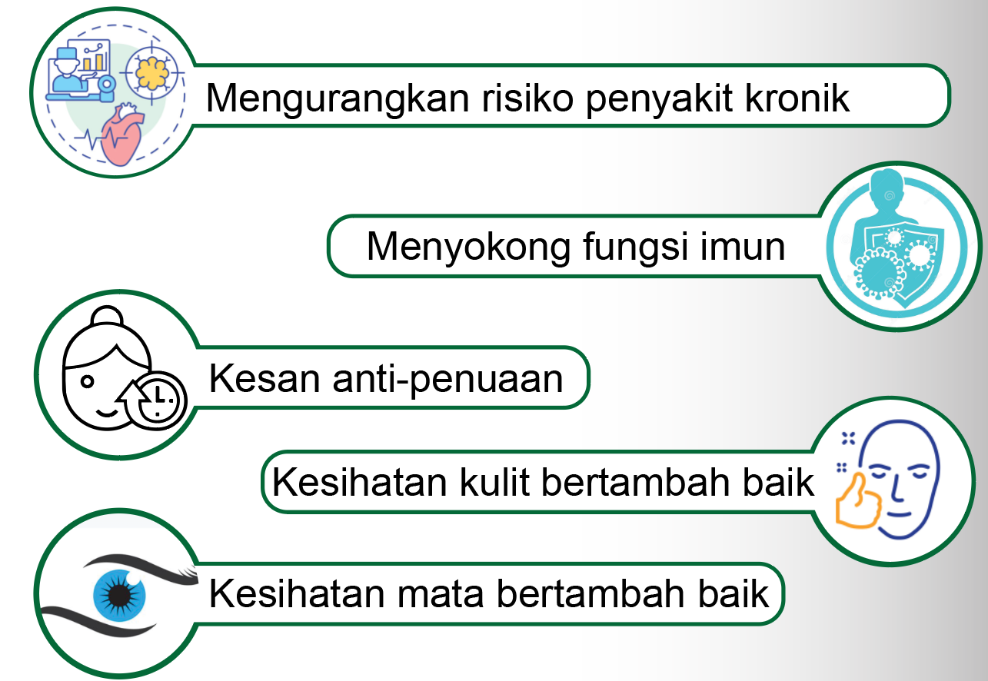
ANTI-OKSIDA
Membantu melindungi daripada kerosakan yang disebabkan oleh
radikal bebas dalam badan

Slide 23
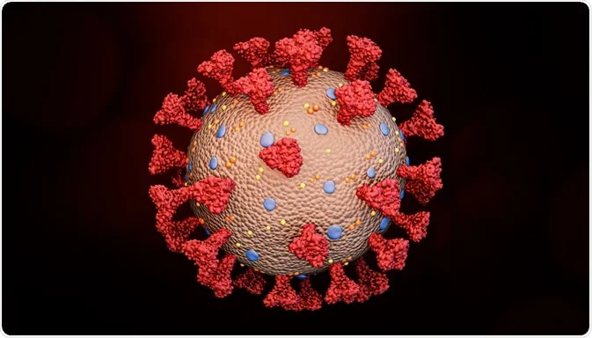
Nigella sativa
and
COVID
A corona virus
SPIKE PROTEINS
SPIKE PROTEINS
SPIKE PROTEINS
SPIKE PROTEINS
SPIKE PROTEINS

Slide 24
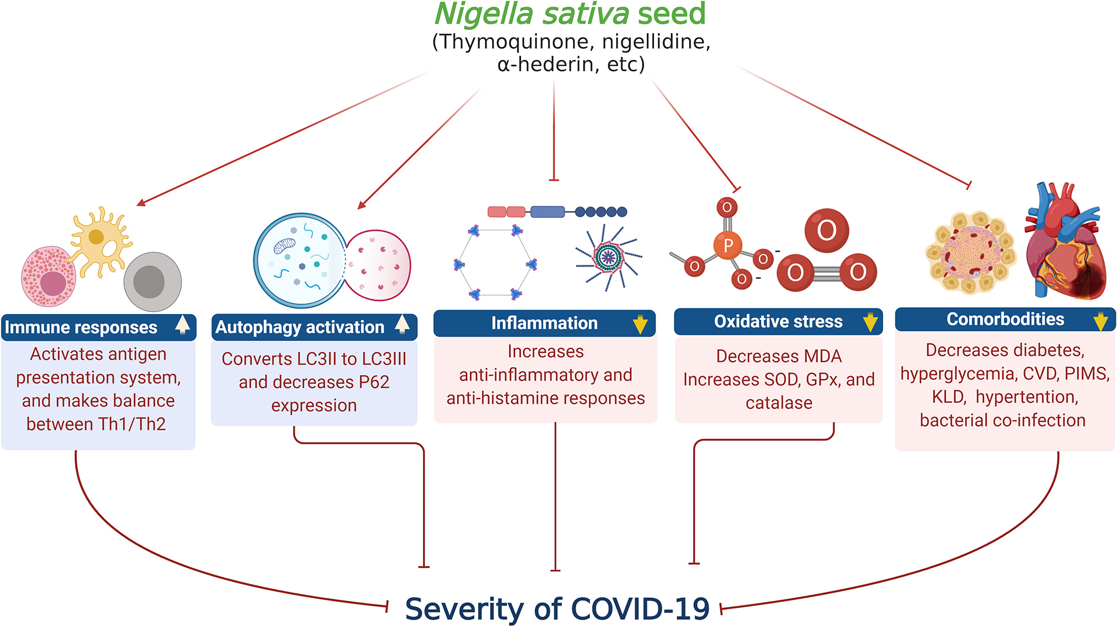
COVID-19

Slide 25
Why do we need
Nigella sativa?
TAKE Nigella sativa EVERYDAY,
YOU WILL BE PROTECTED

Slide 26
Why do we need Nigella sativa
Nigella sativa helps build strong immune system and can prevent some of the side effects of drugs and vaccine injections.
Nigella sativa has been shown to slow down cancer progression and to help in cancer prevention.
Nigella sativa contains Thymoquinone that can protect the liver from toxins and contaminants in the body.
Nigella sativa is an energy booster as it improves liver metabolism and lung functions

Slide 27
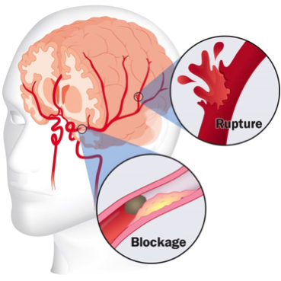
Nigella sativa in STROKES
Stroke still remains a challenge for the researchers and scientists to develop ideal drug.
Neuroprotective effects of aqueous and alcoholic extracts of NS were evaluated in middle cerebral artery-occluded (MCAO) rats.
Locomotor activity and grip strength of the animals were improved and the infarct volume was also reduced in both aqueous and aqueous extracts pre-treated rats.

Slide 28
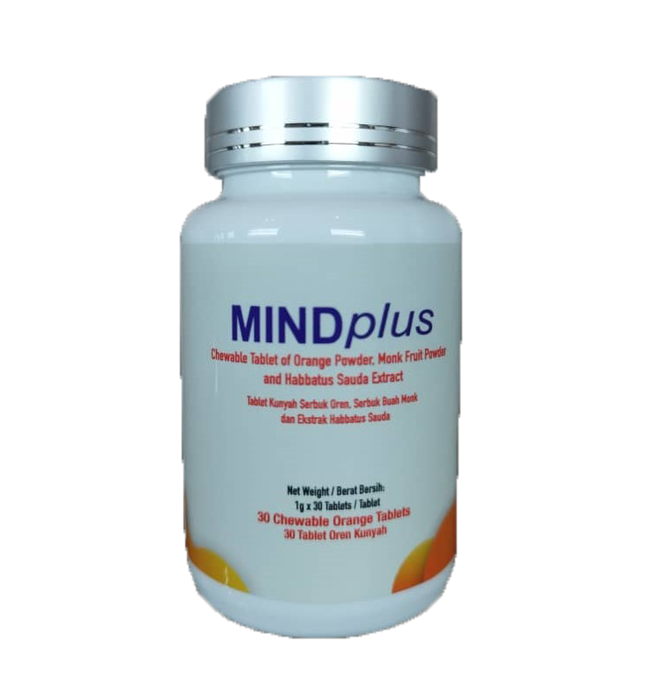
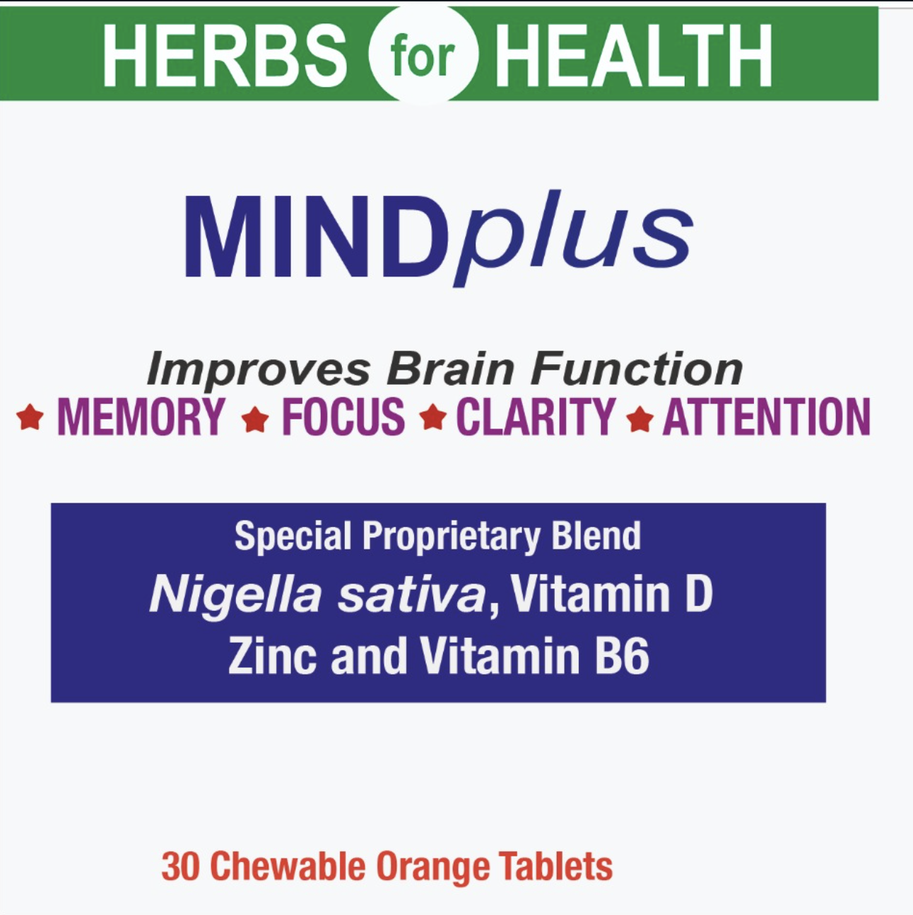

Slide 29
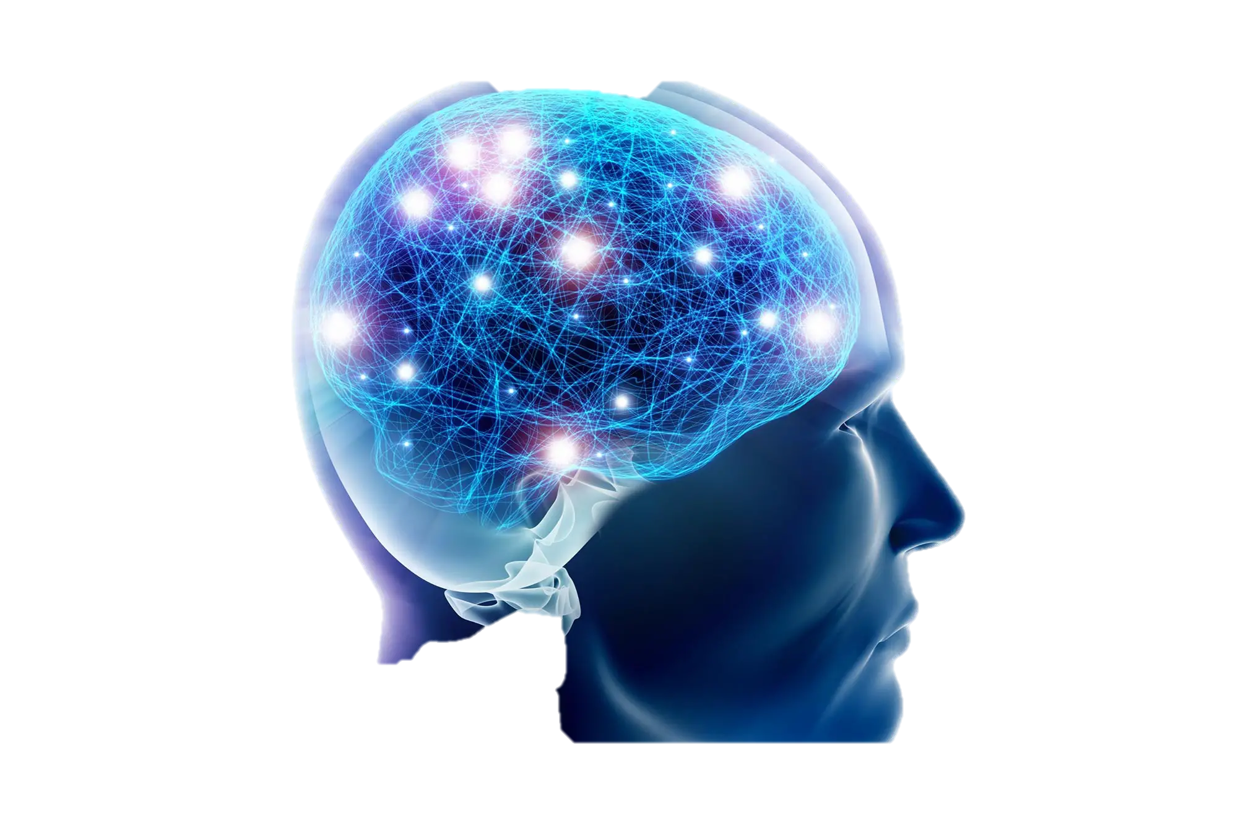
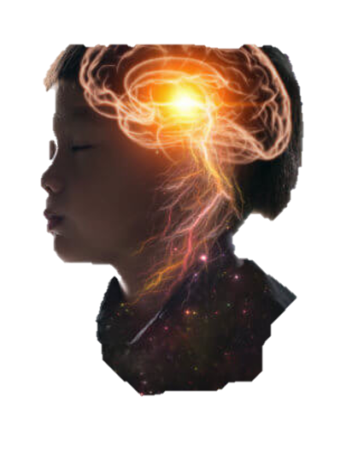
What can MINDplus do?
MINDplus is categorised basically as a food product.
It contains Black seeds (Nigella sativa), monk fruit, Vitamin D, Vitamin B and Zinc.
These components are scientifically proven to protect our nerves and brain and promote the brain development while at the same time improves some of the brain and neurodevelopmental defects in human, especially children.
It has superb medicinal values and effects.
It prevents and regulates inflammatory processes in the braibn which are the main factor in for perfect brain function.

Slide 30
Nigella sativa needs special formulation
MINDplus contains complete 100% Nigella sativa components
Whole seeds
Quinones
Thymoquinone
Dithymoqionone
Thymohydroquinone
Pyrazole Alkaloids
Nigellidine
Nigellicine
Water/
Aqueos extract
Isoquinoline Alkaloids
Nigellicimine
Terpenoids
alpha-phellandrene
Carvacrol
beta-cymene
Alpha pinene
4-Terpineol
Thymol
OIL

Slide 31
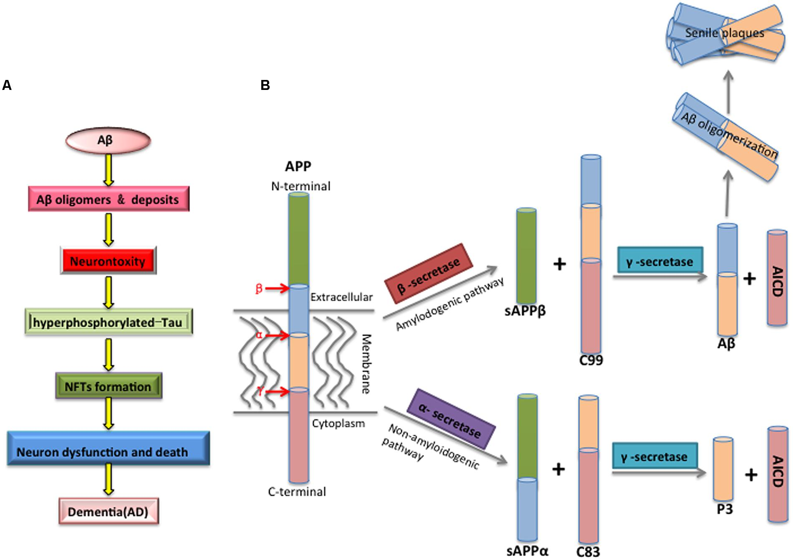
PROTECTION FROM ALZHEIMER’S(NYAYOK) AND PARKINSON’S DISEASE
Alzheimer's disease is characterized by two abnormalities in the brain:
amyloid plaques and neurofibrillary tangles.
Amyloid plaques, which are found in the tissue between the nerve cells, are unusual clumps of a protein called beta amyloid along with degenerating bits of neurons and other cells.
The amyloid β peptide (Aβ) is a critical initiator that triggers the progression of Alzheimer's Disease via accumulation and aggregation.
Thymoquinone protected cultured hippocampal and cortical neurons of embryos of Wistar rat brain against neurotoxicity and cytotoxicity induced by Alzheimer’s disease–specific amyloid beta (Alhebshi et al, 2013).

Slide 32
MINDplus
Nigella sativa in learning and memory impairments
Many studies have been done to evaluate the effects of Nigella sativa on learning and memory.
Nigella sativa can improve learning and memory.
The proposed mechanism(s) for this effect are anti- inflammatory, antioxidant as well as anti- cholinesterase properties.

Slide 33
MINDplus
Nigella sativa, anxiety and depression
Depression is the second most common chronic disease throughout the world.
Estimated that about half of the patients are unaware of their disease or their disease is misdiagnosed
Anxiety is also a complicated disorder in human and animals which may lead to a wide range of problems in the central nervous system (CNS).
It has also been reported that anxiety affects one-eighth of the population and in severe forms it has debilitating effects on the quality of life

Slide 34
MINDplus
&
AUTISM
Nigella sativa

Slide 35
Why do we need MINDplus?
MINDplus helps build strong immune system and can prevent damages or deterioration of the nervous system.
MINDplus has been shown to slow down nerve damage and oxidation and to help in cognitive and brain function.
MINDplus contains Thymoquinone that can protect the liver from toxins and contaminants in the body.
MINDplus is an energy booster as it improves liver metabolism, brain and lung functions
TAKE MINDplus EVERYDAY,
YOU WILL BE PROTECTED

Slide 36
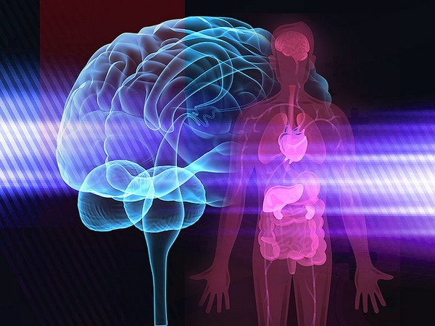
Nigella sativa
Medicine from the prophet (SAW)
Medicine of the past
Medicine of the present
Medicine for the future

Slide 37
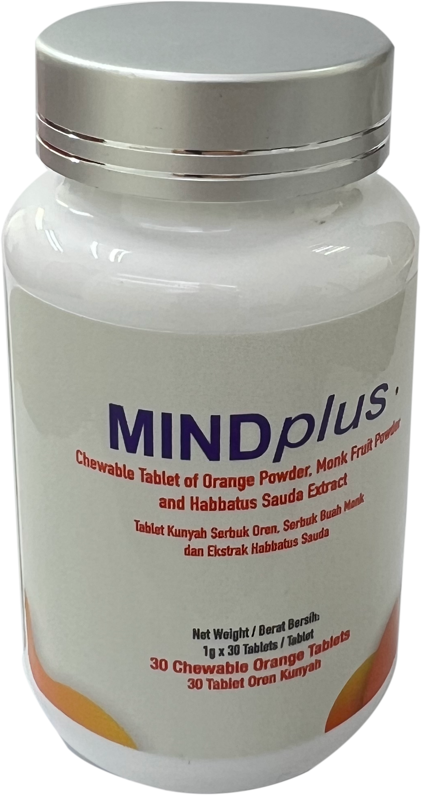
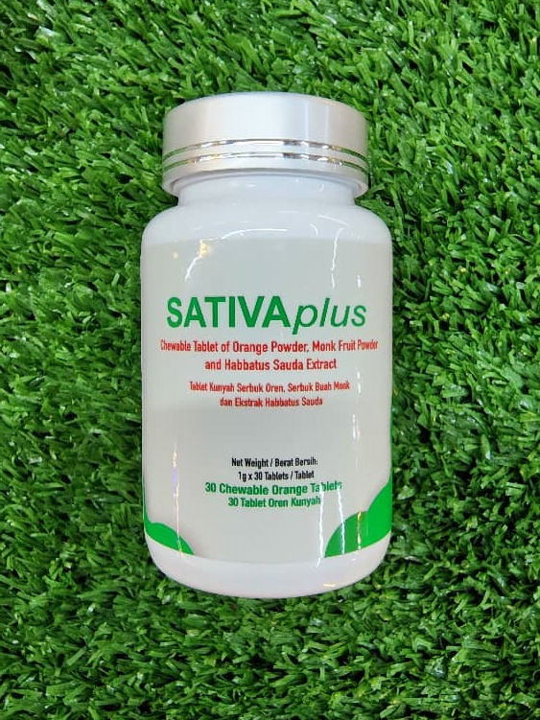
SATIVAplus
MINDplus
PENAWAR HERBAL MEDICINE SDN BHD
NO 29, JALAN SENA 1, TAMAN RINTING, 81750 MASAI, JOHOR, MALAYSIA
www.penawarherbalmedicine.com

